Slide 1

Digital logic design
UNIT-iii
Combinational Logic Design

Slide 2
Unit-III: Combinational Logic Design Syllabus
Single output and multiple output combinational logic circuit design, AND-OR, OR-AND, and NAND/NOR realizations, Exclusive-OR and Equivalence functions
Binary adders/subtractors.
Encoder, Decoder, Multiplexer, Demultiplexer, MUX realization of switching functions, Parity bit generator, Code-converters.
Contact Networks, Hazards and hazard free realizations.
Applications: Design of a 16-bit Magnitude Comparator

Slide 3
DIGITAL CIRCUITS
Digital circuits are of two types:
1. Combinational circuits consist of logic gates whose outputs are determined directly from the present inputs without concerned to previous inputs.
2. Sequential Circuits employ memory elements in addition to logic gates. Their outputs are a function of the present inputs and the present state of the memory elements (previous outputs).

Slide 4
COMBINATIONAL CIRCUITS
A Combinational circuit consists of input variables, logic gates and output variables. The gates accept signals from the inputs and generate signals to the outputs.
Combinational Logic Circuit
n input variables
m output variables
Fig.1: Block Diagram of a Combinational Circuit

Slide 5
Design of Combinational Circuits
The design procedure involves the following steps:
The problem is stated.
The number of available input variables and required output variables are determined.
The input and output variables are assigned letter symbols.
The truth table that defines the required relationship between inputs and outputs is derived.
The simplified Boolean function for each output is obtained.
The logic diagram is drawn.

Slide 6
Design constraints
Minimum no. of gates.
Minimum no. of inputs to the gates.
Minimum propagation delay of the signal through the circuit.
Minimum no. of interconnections
Thus high speed of operation.
Limitations on the driving capabilities of each gate.
Portability, less cost, low power dissipation and more reliability

Slide 7
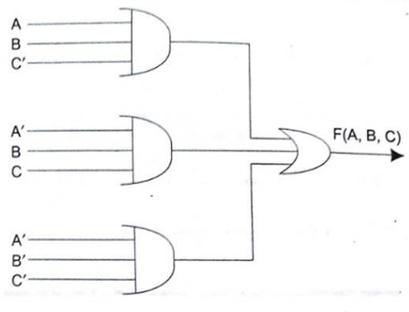
AND – OR Realization (SOP form)
Realize the given function F(A,B,C) = ABC’ + A’BC + A’B’C’ using AND – OR logic.

Slide 8
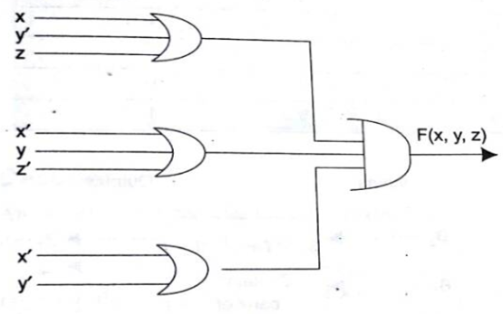
OR – AND Realization (POS form)
Realize the given function F(x,y,z) = (x+y’+z) (x’+y+z’) (x’+y’) using OR – AND logic.

Slide 9
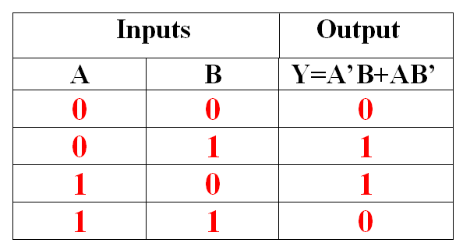
Exclusive-OR gate (XOR gate)
Description ⇒
Output Y is TRUE if either input A OR input B is TRUE, else it is FALSE.
Logic Symbol ⇒
A
XOR
Y
B
Truth Table ⇒
Boolean Expression ⇒
Y = A’B + AB’

Slide 10
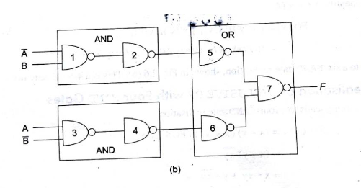
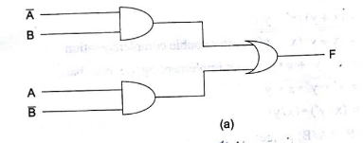
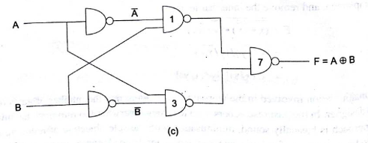
Exclusive-OR gate using AND-OR and NAND gates
F = A’B + AB’
Figure.8: ( a) XOR using AND-OR, (b) &(c) using NAND gates

Slide 11
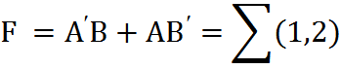
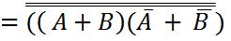
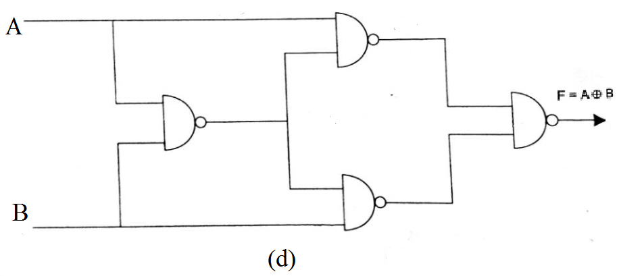
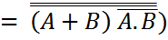
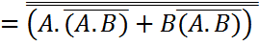
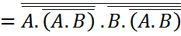
Exclusive –OR with four NAND gates
Apply double complement

Slide 12
Half Adder
A combinational circuit that performs addition of two binary bits and generate to two outputs, i.e., sum and carry is called a Half Adder.
A
Sum
Half Adder
inputs
Outputs
B
Carry

Slide 13
Truth Table for Half Adder
Inputs |  | Outputs
A | B | Carry | Sum
0 | 0 | 0 | 0
0 | 1 | 0 | 1
1 | 0 | 0 | 1
1 | 1 | 1 | 0

Slide 14
K-map simplification for Half Adder
For carry
For sum
A
A
0
1
0
1
B
B
0
0 | 0
0 | 1
0 | 1
1 | 0
0
1
1
Carry = A B
Sum = A B’ + A’B

Slide 15
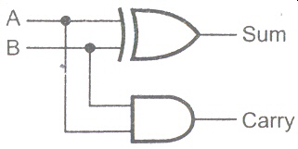
Logic diagram for half adder
= A B’ + A’B
= A B

Slide 16
Full Adder
A combinational circuit that performs addition of three binary bits is called a Full Adder.
C_{in}
A
Full Adder
Sum
B
C_{out}

Slide 17
Truth table for full adder
A | B | C_{in} | Carry | Sum
0 | 0 | 0 | 0 | 0
0 | 0 | 1 | 0 | 1
0 | 1 | 0 | 0 | 1
0 | 1 | 1 | 1 | 0
1 | 0 | 0 | 0 | 1
1 | 0 | 1 | 1 | 0
1 | 1 | 0 | 1 | 0
1 | 1 | 1 | 1 | 1

Slide 18
K map simplification for full adder
For carry
For sum
B C_{in}
B C_{in}
00 01 11 10
00 01 11 10
A
A
0
1
0 | 0 | 1 | 0
0 | 1 | 1 | 1
0
1
0 | 1 | 0 | 1
1 | 0 | 1 | 0
C_{out} = AB + AC_{in} + BC_{in}
Sum = A’B’C_{in} + A’BC_{in}’+AB’C_{in}’ + ABC_{in}

Slide 19

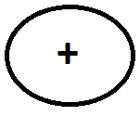
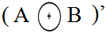
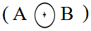
Sum = A’B’C_{in} + A’BC_{in}’ +AB’C_{in}’ + ABC_{in}
= C_{in} (A’ B’ + A B ) + C_{in} ’ (A’ B + A B’)
= C_{in} ( A
B) + C_{in}’ ( A B
)
= C_{in}
+ (C_{in} )’
= C_{in}
( A B)

Slide 20
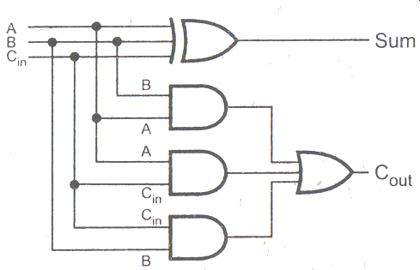
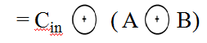
Logic diagram for full adder
= A B + A C_{in} + B C_{in}

Slide 21
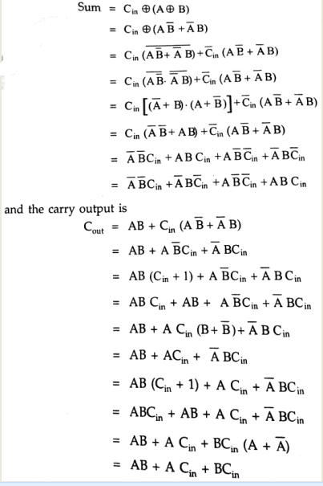
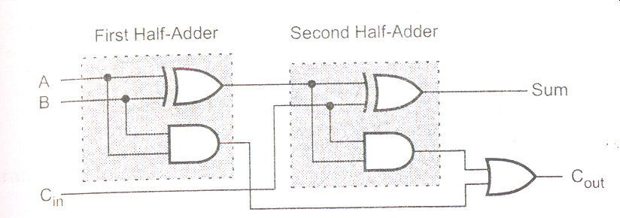
Implementation of full adder with two half adders and an OR gate

Slide 22
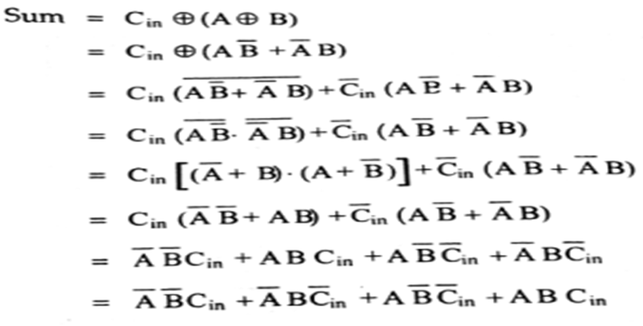

Slide 23
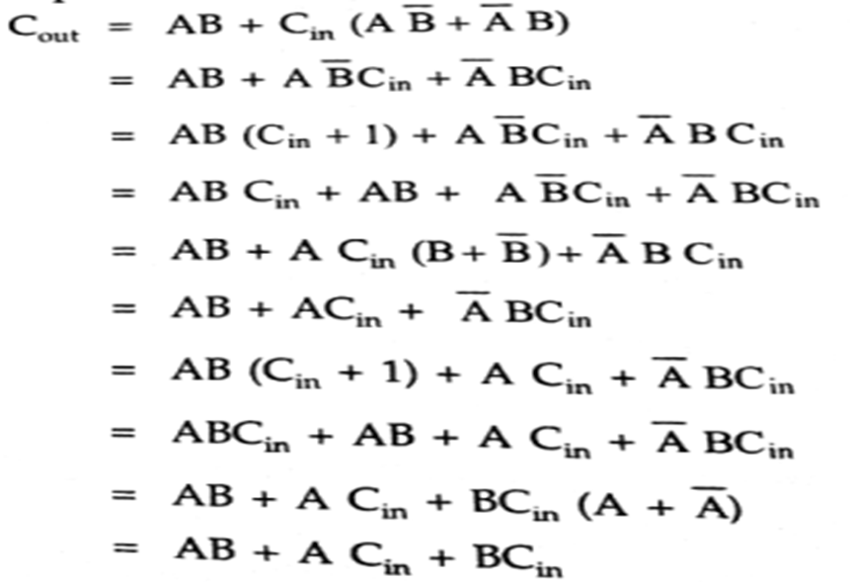

Slide 24
Half Subtractor
A combinational circuit that subtracts two bits and produces their difference is called Half Subtractor. It also has an output to specify if a 1 has been borrowed.
A
Difference
Half Subtractor
Outputs
inputs
B
Borrow

Slide 25
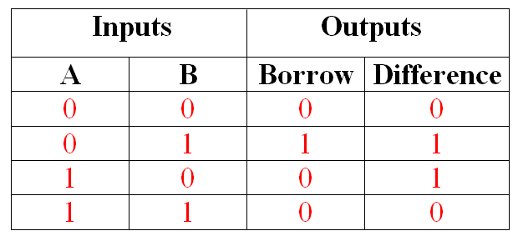
Truth Table for Half Subtractor

Slide 26
K map simplification for half subtractor
For Difference
For Borrow
A
A
0
1
0
1
B
B
0
0 | 0
1 | 0
0 | 1
1 | 0
0
1
1
Difference = A B’ + A’ B
Borrow = A’ B

Slide 27
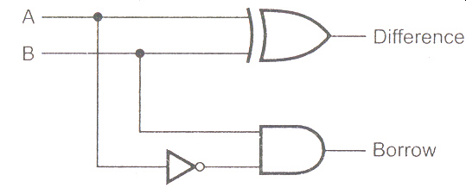
Logic diagram for half subtractor

Slide 28
Full Subtractor
A combinational circuit that subtracts Three bits and produces their difference is called Full Subtractor.
Borrow_{in}
A
Difference
Full Subtractor
B
Borrow_{out}

Slide 29
Truth table for full subtractor
A | B | Bin | Bout | Difference
0 | 0 | 0 | 0 | 0
0 | 0 | 1 | 1 | 1
0 | 1 | 0 | 1 | 1
0 | 1 | 1 | 1 | 0
1 | 0 | 0 | 0 | 1
1 | 0 | 1 | 0 | 0
1 | 1 | 0 | 0 | 0
1 | 1 | 1 | 1 | 1

Slide 30
K map simplification for full subtractor
For Borrow
For Difference
B B_{in}
B B_{in}
00 01 11 10
00 01 11 10
A
A
0
1
0 | 1 | 1 | 1
0 | 0 | 1 | 0
0
1
0 | 1 | 0 | 1
1 | 0 | 1 | 0
B_{out} = A’ B_{in} + A’ B + B B_{in}
D = A’ B’ B_{in} + A’ B (B_{in} )’ + A B’ (B_{in} )’ + A B B_{in}

Slide 31
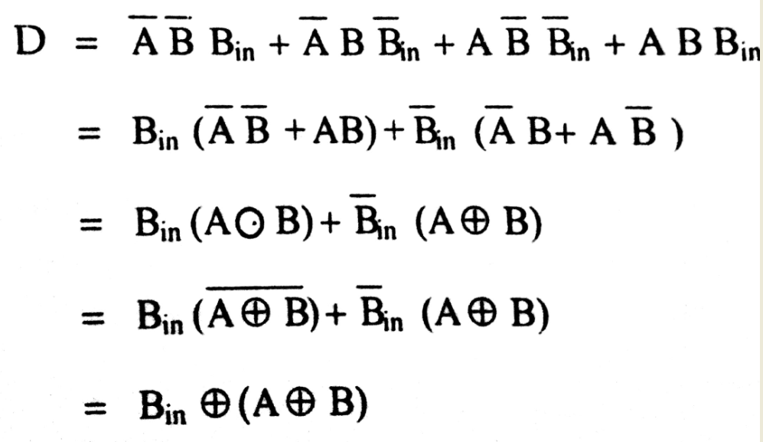
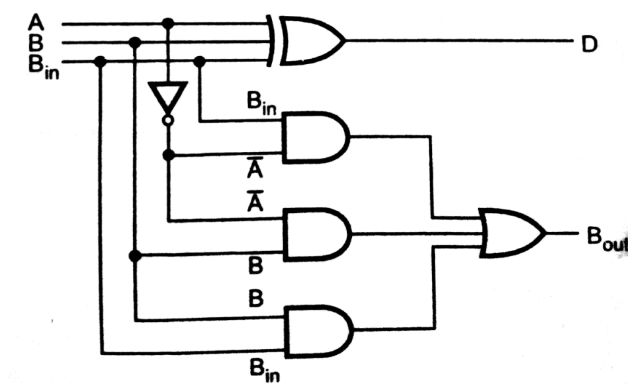
Simplified structure of Full subtractor

Slide 32
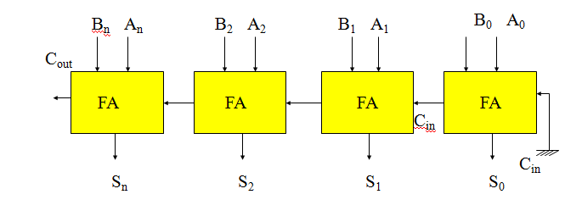
Binary / Parallel Adder
A single full adder is capable of adding two one-bit numbers
In order to add binary numbers with more than one bit , additional Full adders must be employed.

Slide 33
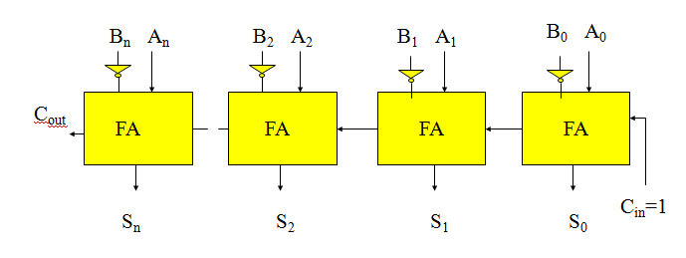
Binary subtractor or Parallel subtractor
The subtraction of binary numbers can be done most conveniently by means of complements
The 1’s complement can be implemented with inverters and a 1 can be added to the sum through input carry

Slide 34
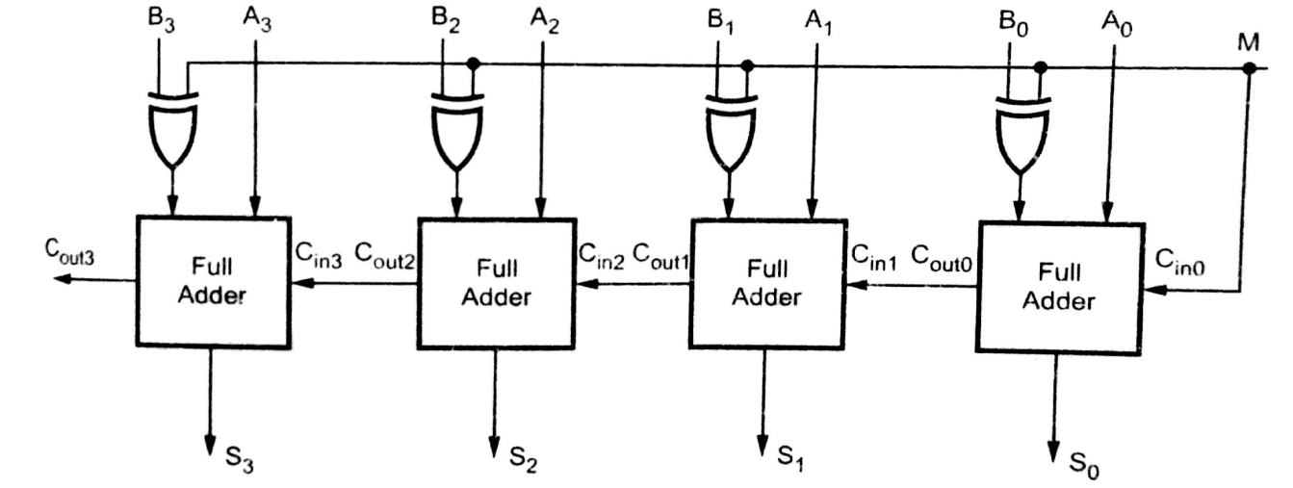
Parallel Adder/Subtractor
The addition and Subtraction operations can be combined in to one circuit.
The mode input M controls the operation of the circuit, when M=0 the circuit is an adder, when M=1 the circuit is an subtractor

Slide 35
Draw back of parallel adder
In parallel adder carry output of each full adder stage is connected to the carry input of the next higher order stage. Therefore, the sum and carry outputs of any stage cannot be produced until the input carry occurs; this leads to a time delay in the addition process. This delay is known as Carry Propagation Delay.
Example:
0 1 0 1
+ 0 0 1 1
1 0 0 0

Slide 36
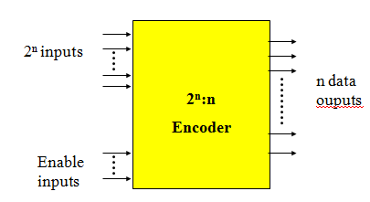
Encoder
An encoder has 2^{n} input lines and n output lines.
In encoder the output lines generate binary code corresponding to the input value.

Slide 37
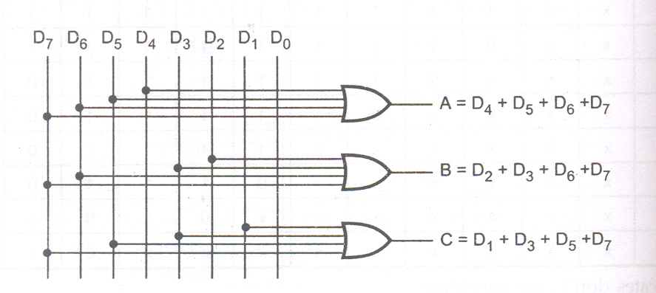
Octal to Binary Encoder
Logic Diagram:
Truth Table:
D₀ | D₁ | D₂ | D₃ | D₄ | D₅ | D₆ | D₇ | A | B | C
1 | 0 | 0 | 0 | 0 | 0 | 0 | 0 | 0 | 0 | 0
0 | 1 | 0 | 0 | 0 | 0 | 0 | 0 | 0 | 0 | 1
0 | 0 | 1 | 0 | 0 | 0 | 0 | 0 | 0 | 1 | 0
0 | 0 | 0 | 1 | 0 | 0 | 0 | 0 | 0 | 1 | 1
0 | 0 | 0 | 0 | 1 | 0 | 0 | 0 | 1 | 0 | 0
0 | 0 | 0 | 0 | 0 | 1 | 0 | 0 | 1 | 0 | 1
0 | 0 | 0 | 0 | 0 | 0 | 1 | 0 | 1 | 1 | 0
0 | 0 | 0 | 0 | 0 | 0 | 0 | 1 | 1 | 1 | 1

Slide 38
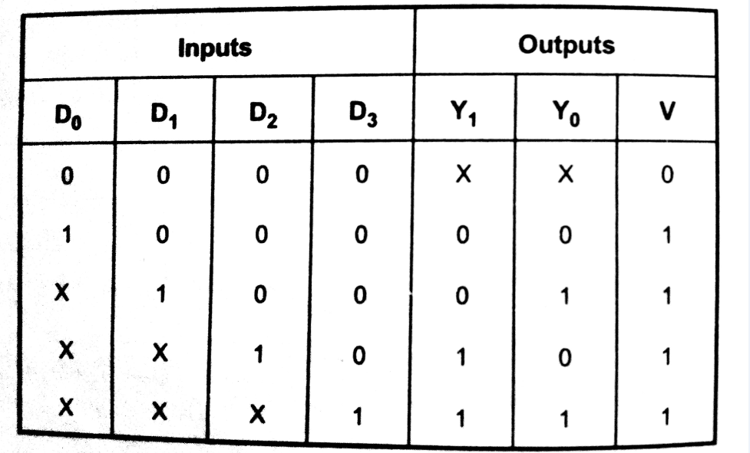
Priority Encoder
A priority encoder is an encoder circuit that includes the priority function.
Truth Table:

Slide 39
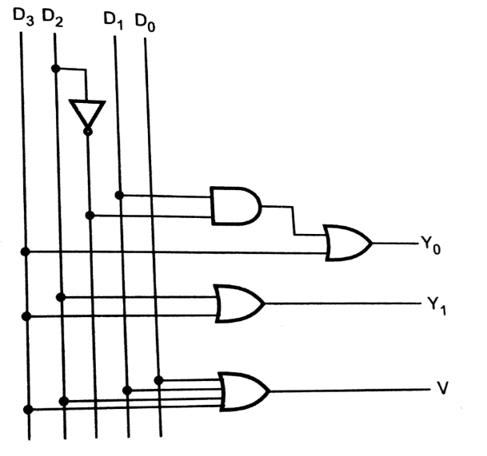
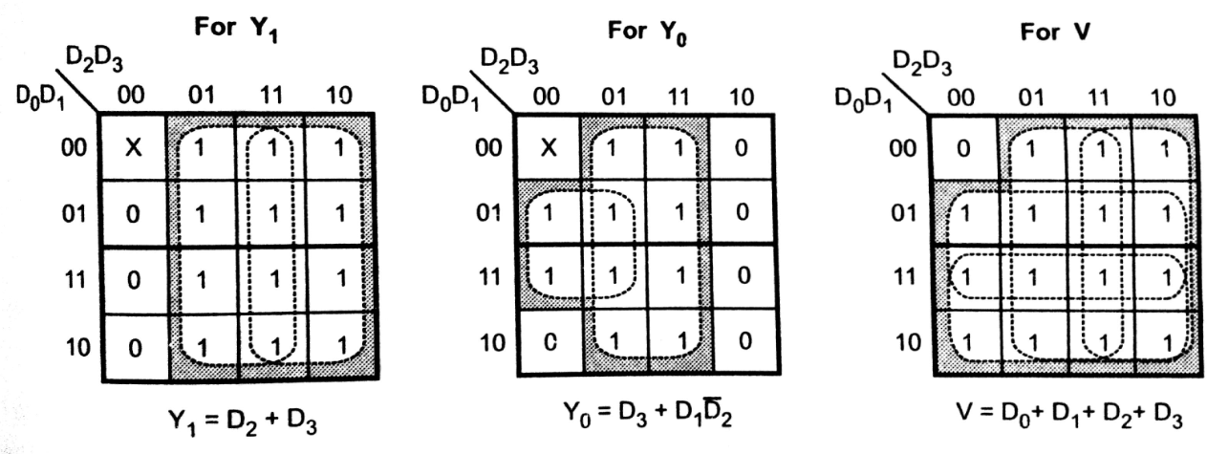
K-Map Simplification Logic Diagram

Slide 40
Decoders
A decoder is a multiple-input, multiple-output logic circuit which converts coded inputs into coded outputs
The input code generally has fewer bits than the output code
Each input code word produces a different output code word
Reverse operation of Encoder

Slide 41
General structure of a decoder
n data inputs
Possible 2^{n} outputs
n : 2^{n}
Decoder
Enable inputs
Decoder is provided with enable inputs to activate decoded output based on data inputs.
When any one enable input is unasserted, all outputs of decoder are disabled.

Slide 42
Binary decoder
A decoder which has an n-bit binary input code and a one activated output out of 2^{n} output code is called binary decoder.
A binary decoder is used when it is necessary to activate exactly one of 2^{n} outputs based on an n-bit input value.

Slide 43
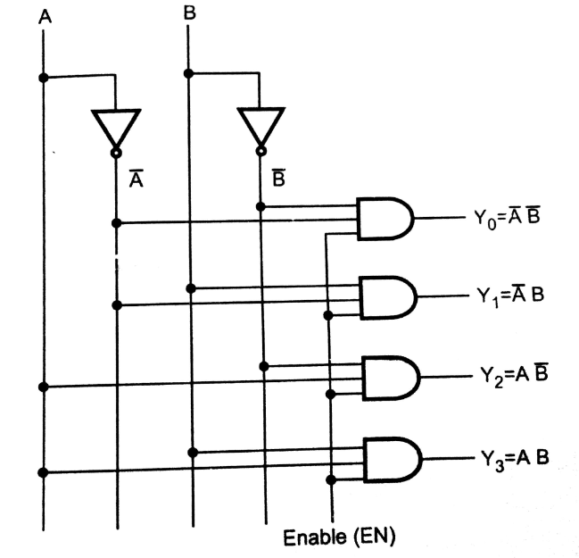
2 TO 4 DECODER
Logic Diagram:
Truth Table:
En | A | B | Y₃ | Y₂ | Y₁ | Y₀
0 | X | X | 0 | 0 | 0 | 0
1 | 0 | 0 | 0 | 0 | 0 | 1
1 | 0 | 1 | 0 | 0 | 1 | 0
1 | 1 | 0 | 0 | 1 | 0 | 0
1 | 1 | 1 | 1 | 0 | 0 | 0

Slide 44
Truth table for 3 to 8 decoder
EN | A | B | C | Y₇ | Y₆ | Y₅ | Y₄ | Y₃ | Y₂ | Y₁ | Y₀
0 | X | X | X | 0 | 0 | 0 | 0 | 0 | 0 | 0 | 0
1 | 0 | 0 | 0 | 0 | 0 | 0 | 0 | 0 | 0 | 0 | 1
1 | 0 | 0 | 1 | 0 | 0 | 0 | 0 | 0 | 0 | 1 | 0
1 | 0 | 1 | 0 | 0 | 0 | 0 | 0 | 0 | 1 | 0 | 0
1 | 0 | 1 | 1 | 0 | 0 | 0 | 0 | 1 | 0 | 0 | 0
1 | 1 | 0 | 0 | 0 | 0 | 0 | 1 | 0 | 0 | 0 | 0
1 | 1 | 0 | 1 | 0 | 0 | 1 | 0 | 0 | 0 | 0 | 0
1 | 1 | 1 | 0 | 0 | 1 | 0 | 0 | 0 | 0 | 0 | 0
1 | 1 | 1 | 1 | 1 | 0 | 0 | 0 | 0 | 0 | 0 | 0

Slide 45
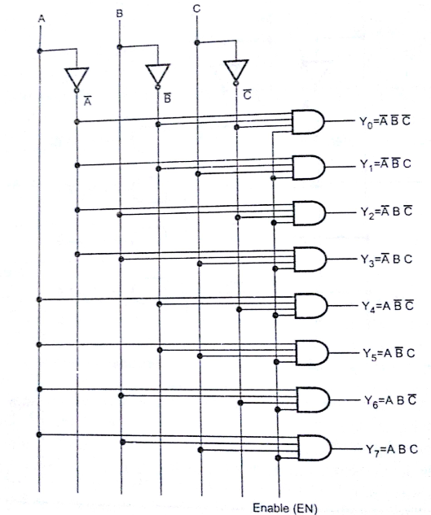
Logic diagram for 3 to 8 decoder

Slide 46
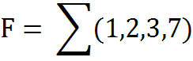
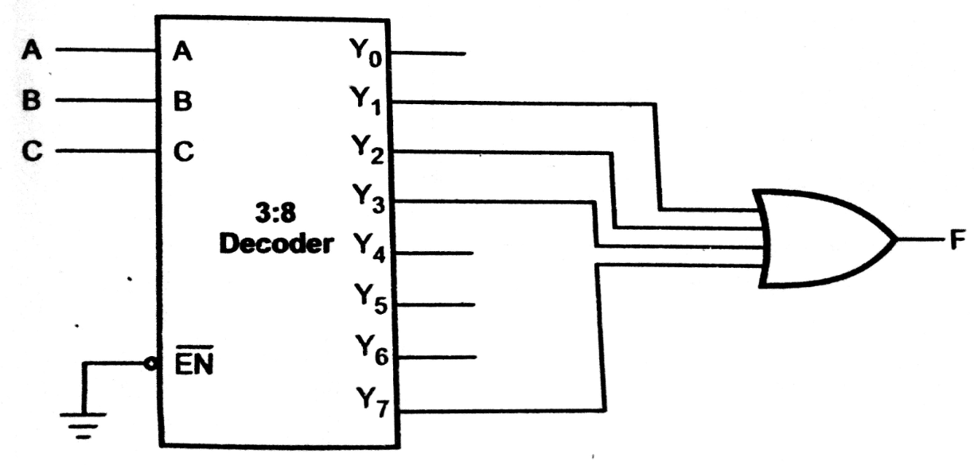
SOP Function Implementation using Decoder
Implement a given function using decoder

Slide 47
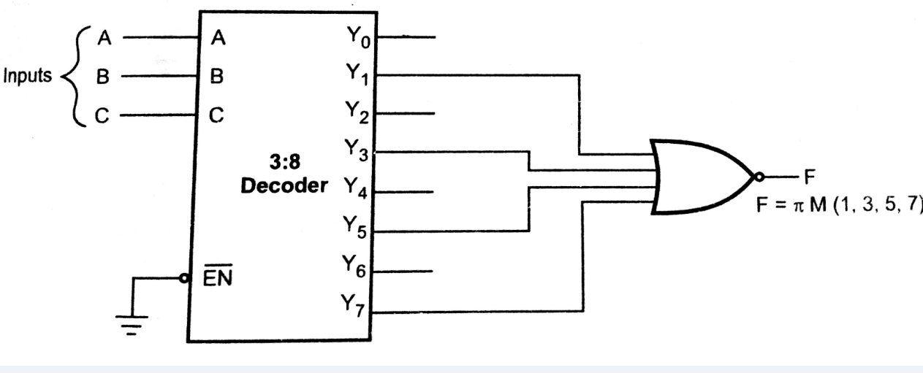
POS Function Implementation using Decoder
Implement given function using decoder F= π ( 1,3,5,7)

Slide 48
Multiplexer
Multiplexer is combinational Circuit having 2^{n} input lines, n selection lines and one output line. Select lines bit combination selects one of the input and data on that input is passed to the output.
Multiplexer is a digital switch. It allows digital information from several sources to be routed onto a single output line.
The selection of a particular input line is controlled by a set of selection lines.

Slide 49
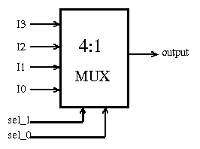
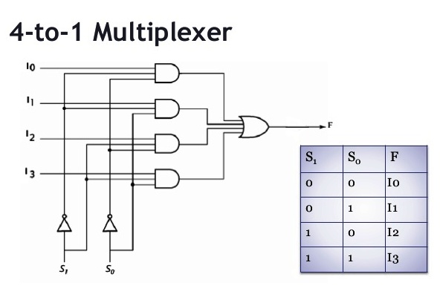
4 to 1 line multiplexer

Slide 50
MUX realization of switching functions
A multiplexer consists of a set of AND gates whose outputs are connected to single OR gate.
Any boolean function in a SOP form can be realized using multiplexer.
Each AND gate in a multiplexer represents a minterm.
In 8 to 1 MUX, there are 3 select inputs and thus 2³ minterms.

Slide 51
By connecting the function variables directly to the select inputs, a multiplexer can be made to select the AND gate that corresponds to the minterm of the function.
If a minterm exists in a function
Connect the AND gate data input to logic 1
Otherwise connect it to logic 0.

Slide 52
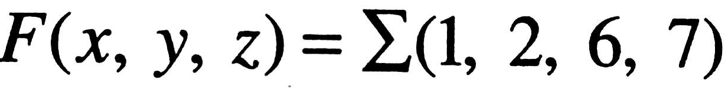
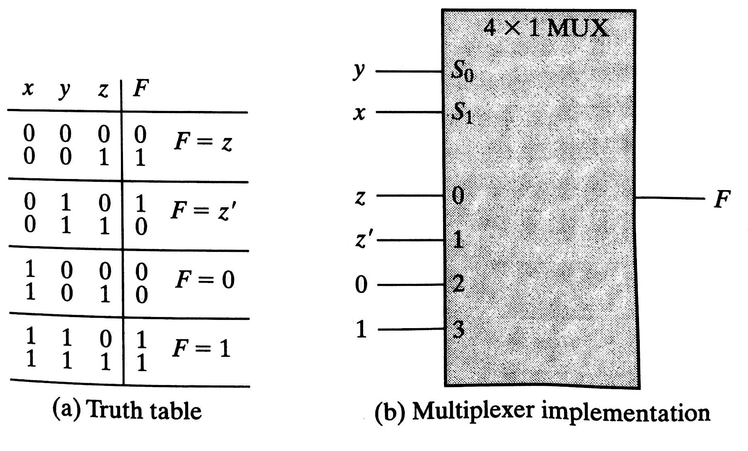
Ex-1: Implement Combinational logic for the following function using Multiplexer

Slide 53
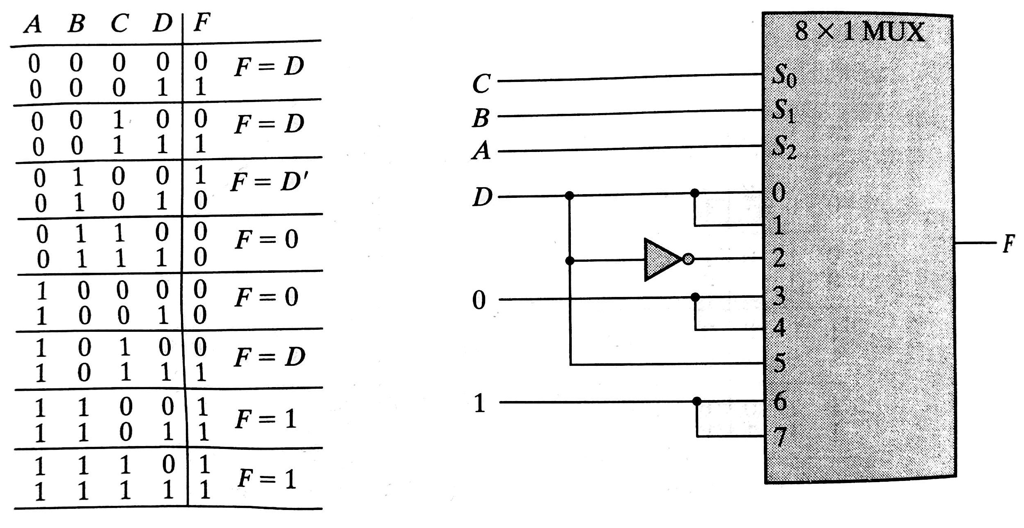
Ex-2: Realize the following function using Multiplexer

Slide 54
DEMULTIPLEXERS
Demultiplexer is combinational Circuit having one input line, n selection lines and 2^{n} output lines
It receives information on a single input line and transmits this information on one of 2^{n} possible output lines.
The selection of a particular output line is controlled by a set of selection lines.

Slide 55
1 to 4 Demultiplexer
Y₀
Y₁
Y₂
Y₃
D_{in}
2^{n} output lines
1 to 4 Demux
One input line
S₁ S_{o}
n selection lines
Logic symbol of 1- to- 4 demultiplexer

Slide 56
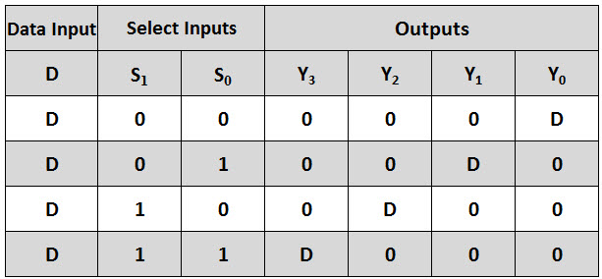
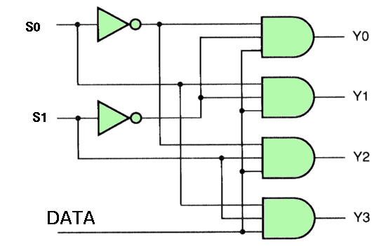
1 to 4 Demultiplexer
Logic Diagram:
Truth Table:

Slide 57
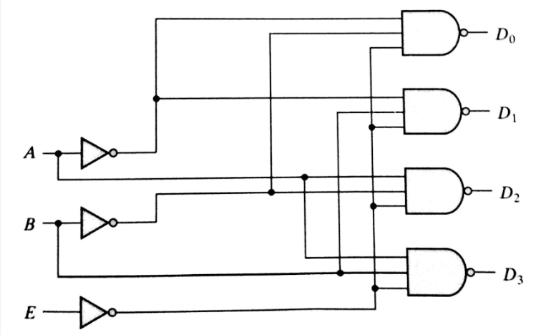
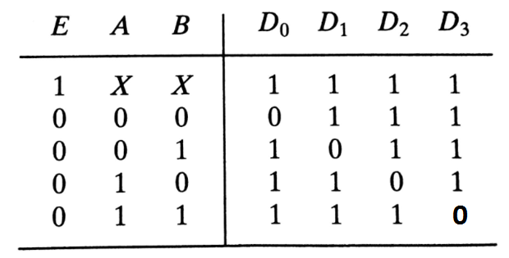
Decoder as a de-multiplexer
Decoder with enable input is also called as Demultiplexer
Truth Table:
Logic Diagram:

Slide 58
PARITY BIT GENERATOR
A parity bit is used for the purpose of detecting errors during transmission of binary information.
The circuit that generates the parity bit in the transmitter is called a parity generator.
Parity bit generators are of two types
Odd parity generator
Even parity generator

Slide 59
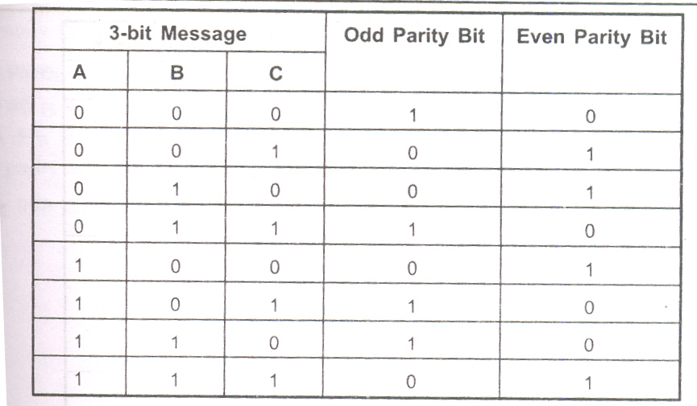
Parity generator truth table for even and odd parity

Slide 60
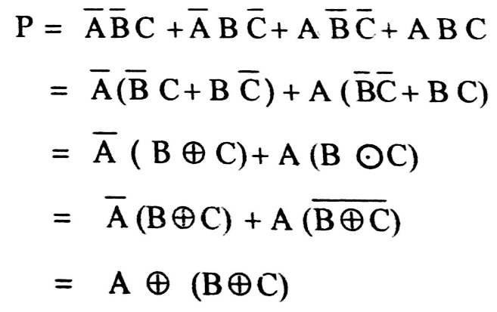


Even parity-bit generator
K-map Simplification:
Logic Diagram:

Slide 61
Parity Checker
The circuit that checks the parity in the receiver is called a parity checker.
The output of parity checker is denoted by PEC.
PEC is equal to 1, if an error occurs,
else PEC is equal to 0.

Slide 62

Truth table for Even parity checker

Slide 63


K-map Simplification:
Logic diagram:

Slide 64
Code converters
Digital systems use wide variety of binary codes. Some of those codes are Binary-Coded-Decimal(BCD), Excess-3, Gray etc. Many times it is required to convert one code to another.
Examples of code converters:
Binary to BCD code converter
BCD to Excess-3 code converter

Slide 65


Binary to BCD Code converter
K-map Simplification:
Truth Table:

Slide 66

Logic Diagram:

Slide 67


BCD-to-Excess-3 code Converter
K-map Simplification:
Truth Table:

Slide 68

Logic Diagram:

Slide 69

Magnitude comparator
A magnitude digital comparator is a combinational circuit that compares two digital or binary numbers (consider A and B) and determines their relative magnitudes in order to find out whether one number is equal, less than or greater than the other digital number.
Three binary variables are used to indicate the outcome of the comparison as A>B, A<B, or A=B

Slide 70

Single Bit Magnitude Comparator
Truth Table
A | B | A<B | A>B | A=B
0 | 0 | 0 | 0 | 1
0 | 1 | 1 | 0 | 0
1 | 0 | 0 | 1 | 0
1 | 1 | 0 | 0 | 1

Slide 71

Truth Table
A | B | A<B | A>B | A=B
0 | 0 | 0 | 0 | 1
0 | 1 | 1 | 0 | 0
1 | 0 | 0 | 1 | 0
1 | 1 | 0 | 0 | 1

Slide 72


Slide 73

Truth Table

Slide 74
Hazards and hazard free realizations
Hazards are unwanted switching transients that may appear at the output of a circuit because different paths exhibit different propagation delays.
Hazards occur in combinational circuits, where they may cause a temporary false output value.
When they occur in asynchronous sequential circuits, hazards may result in a transition to a wrong stable state.

Slide 75
Hazards and hazard free realizations
Hazards are classified into two types, namely, static and dynamic
Static Hazard–The output undergoes a momentary transition when it is supposed to remain unchanged.
Dynamic Hazard–The output changes more than once when it is supposed to change just once

Slide 76

Hazards and hazard free realizations
To visually represent Hazards we will use ‘timing diagram’
This shows the logical value of a signal as a function of time, for example the following timing diagram shows a transition from 0 to 1 and then back again

Slide 77


Types of Hazards
Static Hazard
Dynamic Hazard

Slide 78

Static-1 Hazard

Slide 79
Hazard Removal
To remove a 1 hazard, draw the K-map of the output concerned. Add another term which overlaps the essential terms.
To remove a 0 hazard, draw the K-map of the complement of the output concerned. Add another term which overlaps the essential terms (representing the complement).

Slide 80

Removing the Static-1 Hazard

